Slide 1
Galactic Archaeology Program:
K2 red giant Asteroseismology
using Bayesian Asteroseismology data Modeling (BAM)
AAS 229: Galactic Archaeology with Kepler and K2
6 January 2016
Joel C. Zinn
Ohio State University
D. Stello, M. H. Pinsonneault, J. Johnson,
and the APOKASC collaboration

Slide 2
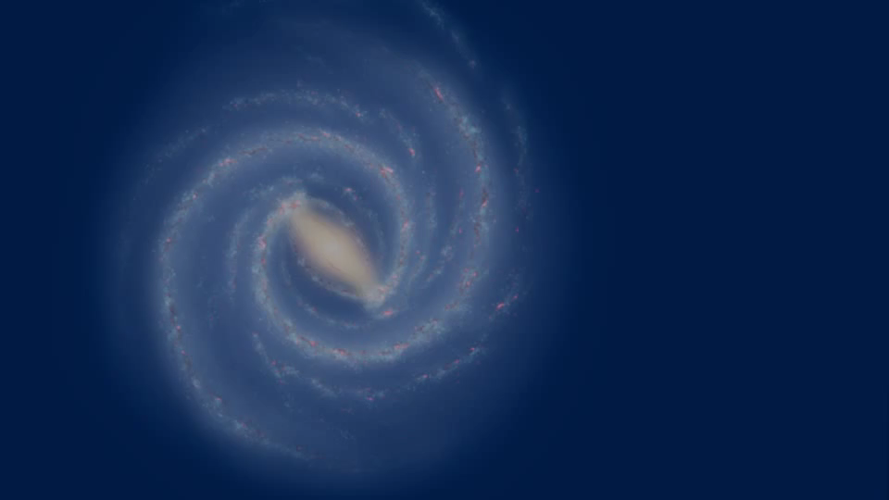
Why use K2 for galactic archaeology?
K2 red giant asteroseismology
Joel C. Zinn
Notes:
K2 offers views of diverse stellar environments — metallicity, bulge, halo, disc
Red giant oscillators give precise (10%) ages, masses (10%), and radii (5%)
Galactic archaeology!

Slide 3

Kepler / K2 pros and cons
Kepler
Single field of view
~1500 day baseline
170k objects in field of view
4 reaction wheels
10s attitude adjustment bandwidth
K2
360º view of ecliptic
~80 day baseline
15-25k objects per campaign
2 reaction wheels — 6 hour thruster
50s (20s > C3) attitude adjustment bandwidth
K2 red giant asteroseismology
Joel C. Zinn

Slide 4



Asteroseismology primer
K2 red giant asteroseismology
Joel C. Zinn
Notes:
depending on how well can measure numax, can get very precise logg:
\mathrm{Relative\ flux}\ [ppm].

Slide 5
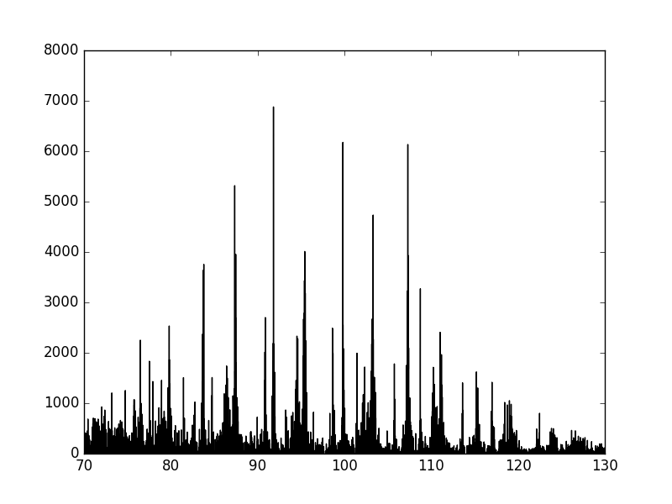
Asteroseismology primer
K2 red giant asteroseismology
Joel C. Zinn
Notes:
depending on how well can measure numax, can get very precise logg:
\mathrm{Relative\ flux}\ [ppm].

Slide 6



—
K2 red giant asteroseismology
Joel C. Zinn
Notes:
depending on how well can measure numax, can get very precise logg:
(error of 70 K for APOGEE, with 5000 K star means termpature contribution is ~ 1/2*1.4 % = 0.7%)
(error on numax is ~ 3% so error in logg is 1.5% ish)
sun is 5 min
47 muhz is six hrs

Slide 7


—
K2 red giant asteroseismology
Joel C. Zinn
Notes:
depending on how well can measure numax, can get very precise logg:
(error of 70 K for APOGEE, with 5000 K star means termpature contribution is ~ 1/2*

Slide 8
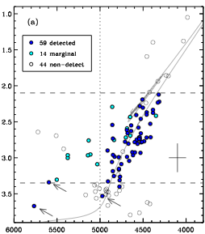


GAP K2-APOGEE red giants
K2 red giant asteroseismology
Stello+ 2015
Joel C. Zinn
Notes:
pilot sample
117 stars with logg < 3.8 from APOGEE in K2 C1.
vertical lines show long = 1.9 and 3.2. vertical dashed line shows nominal teff limit from pinsonneault+ 2014 for stars showing oscillations and those not showing osc
\mathrm{APOGEE}\ \log g
\mathrm{APOGEE}\ T_{\mathrm{eff}}
put slide before about kepler and k2 introducing the problems that make k2 harder

Slide 9
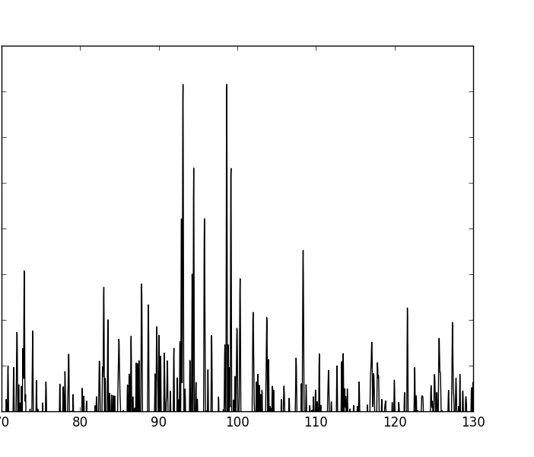
Kepler versus K2 asteroseismology
K2 red giant asteroseismology
Joel C. Zinn
Notes:
depending on how well can measure numax, can get very precise logg:
(error of 70 K for APOGEE, with 5000 K star means termpature contribution is ~

Slide 10
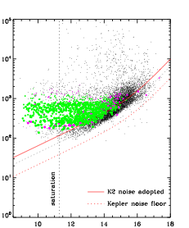


K2 challenges: white noise
K2 red giant asteroseismology
Stello, Zinn+ 2016
Joel C. Zinn
Notes:
0.5~\mathrm{hr~precision} [ppm].
Kp
white noise is ~2-3x larger for K2 than for Kepler

Slide 11
K2 challenges: white noise
Kepler giants H < 11
K2 red giant asteroseismology
Stello, Zinn+ 2016
Joel C. Zinn
Notes:
0.5~\mathrm{hr~precision} [ppm].
Kp
white noise is ~2-3x larger for K2 than for Kepler

Slide 12
K2 challenges: white noise
GAP K2 giants H < 13
Kepler giants H < 11
K2 red giant asteroseismology
Stello, Zinn+ 2016
Joel C. Zinn
Notes:
0.5~\mathrm{hr~precision} [ppm].
Kp
white noise is ~2-3x larger for K2 than for Kepler

Slide 13
Kepler resolution
~0.01 microHertz
K2 challenges: white noise
K2 resolution
~0.4 microHertz
K2 red giant asteroseismology
Joel C. Zinn
Notes:
9.217 Kp
logg 3.011
Z -0.180
18 quarters

Slide 14
Systematic error at ~47
K2 red giant asteroseismology
Joel C. Zinn
Notes:
Systematic errors can mimic true oscillators
\mathrm{Power~density} [ppm/\mu\mathrm{Hz}].
\mathrm{Frequency} [\mu\mathrm{Hz}].

Slide 15
Systematic error at ~47
Thruster firing
K2 red giant asteroseismology
Joel C. Zinn
Notes:
Systematic errors can mimic true oscillators
\mathrm{Power~density} [ppm/\mu\mathrm{Hz}].
\mathrm{Frequency} [\mu\mathrm{Hz}].

Slide 16
K2 challenges and proposed solutions
Statistical error
Resolution
Systematic errors
Six K2-friendly asteroseismology pipelines (Stello, Zinn+2016)
CAN (Kallinger+ 2016)
COR (Mosser & Appourchaux 2009)
BHM (Elsworth in prep.)
A2Z+ (Mathur+ 2010)
SYD (Huber+ 2009)
BAM (Zinn+ in prep.)
K2 red giant asteroseismology
Joel C. Zinn
Notes:
Requires special treatment
6 independent methods have been tested in Stello+ 2016 for K2 asteroseismology
FIX
“The change in bandwidth for pointing control (from 50 to 20 seconds) for C3 resulted in an increase in SNR for short cadence by a factor of roughly 4--9, with the larger improvement seen at the higher frequency end. Note, the bandwidth pointing control parameter was set to 10 seconds for the original Kepler Mission. “ (https://keplerscience.arc.nasa.gov/K2/C3drn.shtml)
set lower because of increased sensor noise because of one tracking star instead of ten because of increased aperture sizes
number of targets decreased from 170,000 in Kepler to 15,000 -- 25,000 in K2

Slide 17
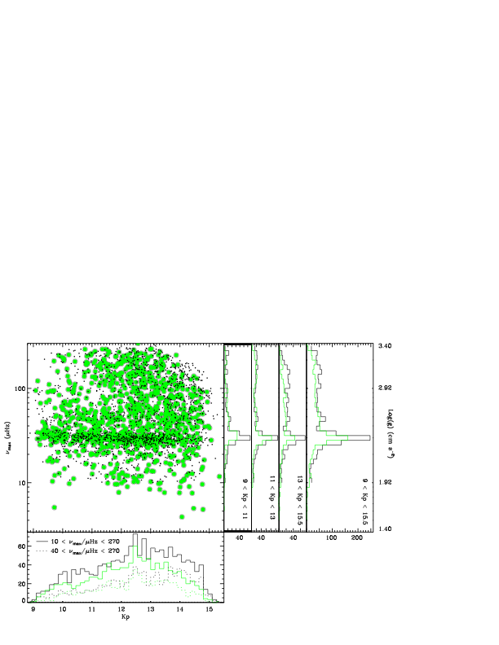
Complete RG sample for
2.5 < < 3.3
K2 red giant asteroseismology
Stello, Zinn+ 2016
Joel C. Zinn
Notes:
complete between 40 and 270 muhz
1200 confirmed oscillators out of 8600
see Chaplin+ 2011 for predicting whether or not something is observable.

Slide 18
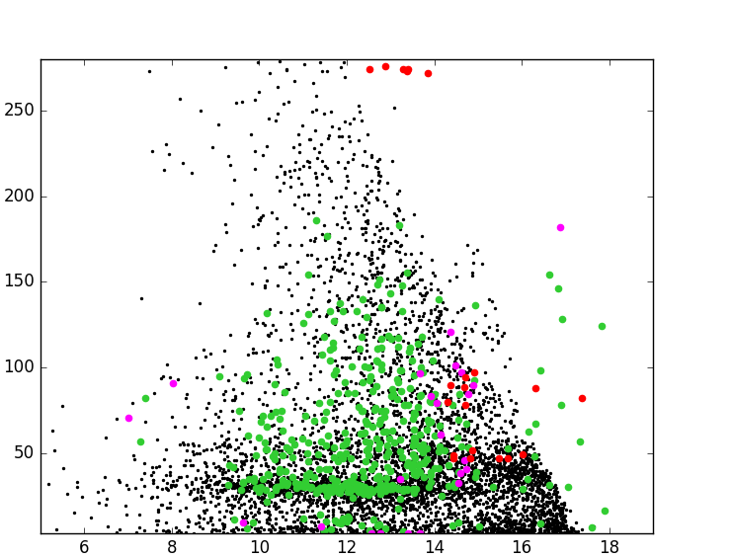
C1 RG at Kp~18 with BAM
K2 red giant asteroseismology
Zinn+ in prep.
Joel C. Zinn
Notes:
If we look at all C1 objects and not just GAP targets, we see oscillations down to 18 Kp
GAP selection function didn’t allow us to probe those magnitudes.
put all comparison sides on same slide
top kepler bottom k2

Slide 19
GAP successes and to-dos
> 12k oscillating red giants expected from GAP from K2 C1-C10
Complete sample of masses and radii for RG
RG Kp < 15 and 2.5 < log g < 3.3
5-10 Rsun +/- 5%, 1-3 Msun +/- 10% (but improvements with Gaia)
log g +/- 0.3% for 70% RC
Masses and radii for 30% RC (but improvements with Gaia)
8-15 Rsun, 1-3 Msun
Luminous red giants with log g~1.9 and fainter stars with BAM
K2 red giant asteroseismology
Joel C. Zinn
Notes:
C10: 8947
C9: 6185
C7: 4362
C6: 8312
C5: 9828
C4: 6357
C3: 3904
C2: 5138
C1: 8630
total: 61 663
18% recovery in C5
assuming 20%:
12 333 stars would be red giants
but this is dependent on the field coordinates
Gaia will help with red clump fundamental parameters because we can get a parallactic radius
WE HAVE ANALYZED C1 IN ETAIL TO INVESTIGATE SYSTEMATICS THOROUGHLY BUT BAM HAS YIELDED FUNAMENTAL PARAMETERS FOR C1-5 AND ARE LOOKING IN TO IT
MENTION THAT GAIA COULD OBVIATE NEED FOR DNU SO CAN DO PRECISIONS BETTER AND CAN DO RC

